Slide 1

Graph Theory and its Applications
Real world networks’ properties to be modeled
Dr. Arti Arya
Department of Computer Science
and Engineering

Slide 2

Graph Theory and its Applications
Generative models to mimic graph formation, Dynamics in a social graph
Why generative models ?
Dr. Arti Arya
Department of Computer Science and Engineering

Slide 3
Graph Theory and its Applications Disclaimer
The course slides are prepared by Prof. BhaskarJyoti. But various additional inputs are added by me from various reliable resources from Foreign and Indian Universities as well as from sites.
Notes:
Ok. Having said that, lets get back to what we were speaking about.
Input devices. We have seen that the virtual reality eco system largely encompasses three fundamental components that include
HMD – head mounted devices that give you immersive VR experience, we saw some examples in the last class like the HTC VIVE, Oculus Rift, Samsung gear and so on. Some of you have also used few of these and experienced it for a few minutes.
And the second components is the GTD or the Gesture Tracking Devices. We saw a video of Xsense IMU sensors that can accurately estimation the position and orientation of a dancer. we will in the next hour see how these gesture tracking devices work and what are the various technicalities that go into tracking. I will try to keep it as non-mathematical as possible, as the mathematics behind it can get pretty messy and complicated. However, if you are interested in the mathematical aspects, I will be more than happy to discuss.
On the screen you can see that a 3 directional coordinate system is depicted. The 3 primary axes of a 3d coordinate system is X, Y and Z axis. Hear I would like to know where, when and why in your past have you encountered 3 dimensional coordinate system.
Give some time to the students to ponder on
Ok, if I tell you, I have encountered 2 dimension in images, drawings, sketch and so on. While I have encountered 1 dimension when I want to know the temperature currently or current time or something like that. Similar, where and when have you encountered 3D, either consciously or subconsciously.
Explain the roll pitch and yaw concepts.
Degree of freedom

Slide 5
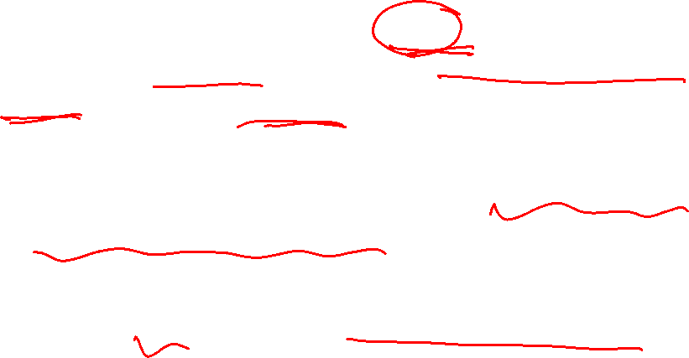
Graph Theory and its Applications
Why are network models necessary ?
In May 2011, Facebook had 721 millions users. A Facebook user at the time had an average of 190 contacts -> a total of 68.5 billion friendships
In social media there are many networks with millions of nodes and billions of edges.
They are complex and it is difficult to analyze them

Slide 6
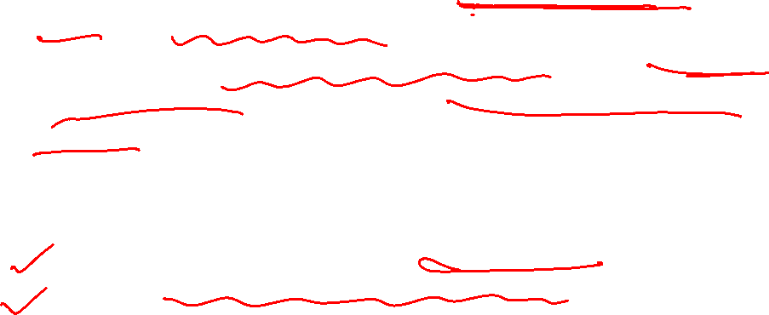
Graph Theory and its Applications
What we do with models ?
We design models that generate, on a smaller scale, graphs similar to real-world networks.
The goal is to accurately model properties observed in real-world networks so that the analysis of real-world networks boils down to a cost-efficient measuring of different properties of simulated networks !
How does it help if it successfully simulates ?
Allow for a better understanding of phenomena observed
Allow for controlled experiments on synthetic networks when real-world networks are not available.

Slide 7

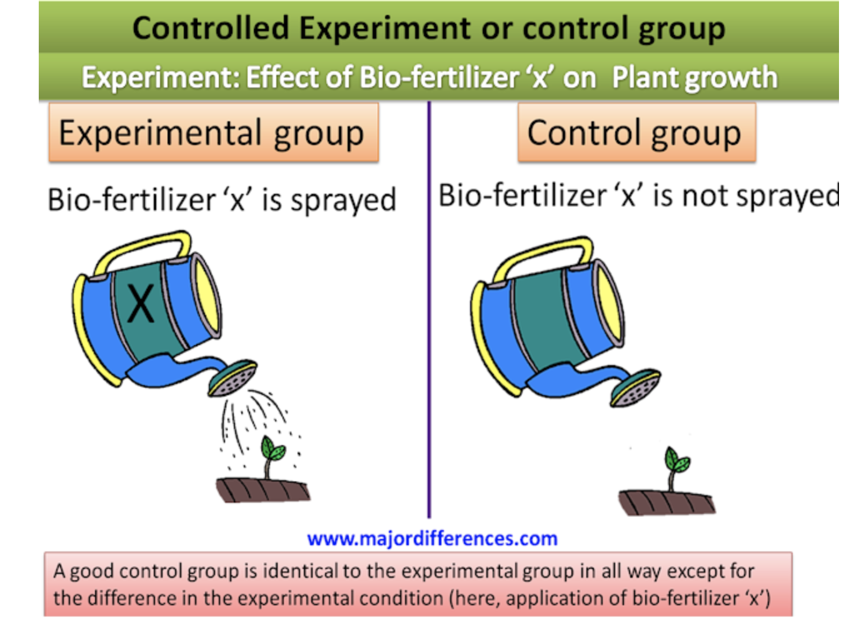
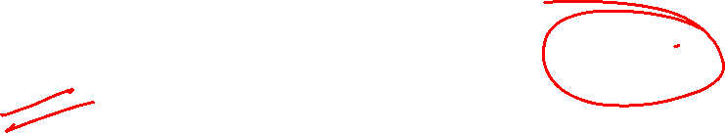
Graph Theory and its Applications
Experimental and Control Groups: Just FYI
In an experimental hypothesis-testing research when a group is exposed to usual conditions, it is termed a ‘control group’,
When the group is exposed to some novel or special condition, it is termed an ‘experimental group’.

Slide 8
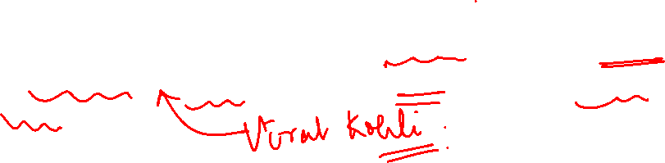
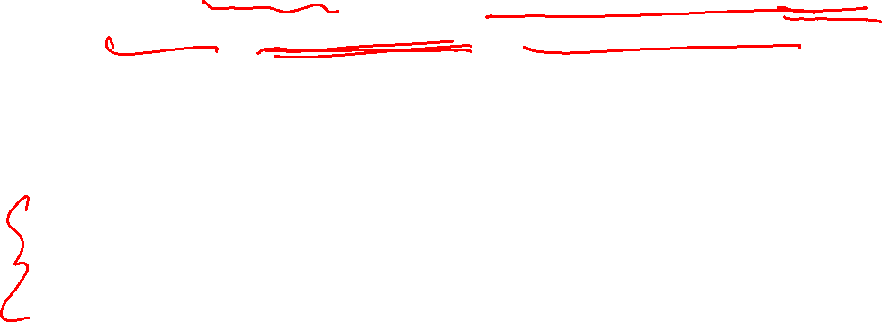
Graph Theory and its Applications
Generative models
These models model the mechanism that drive the network formation
We create graphs that show properties such as power law distribution, small world property, average shortest path
Approach : If the structures resemble real world structures, then this mechanism might be at work in real networks
The power law means that the vast majority of nodes have very few connections, while a few important nodes (we call them Hubs) have a huge number of connections.

Slide 9
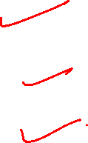
Graph Theory and its Applications
Generative models
A power law distribution (such as a Pareto distribution) describes the 80/20 rule that governs many phenomena around us.
For instance:
80% of a company’s sales often comes from 20% of their customers
80% of a computer’s storage space is often taken up by 20% of the files
80% of the wealth in a country is owned by 20% of the people

Slide 10
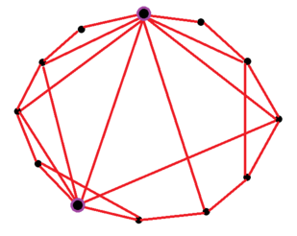
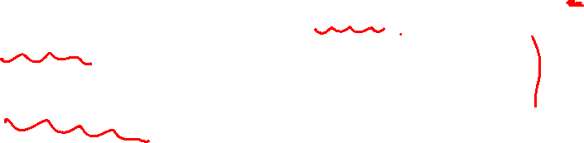
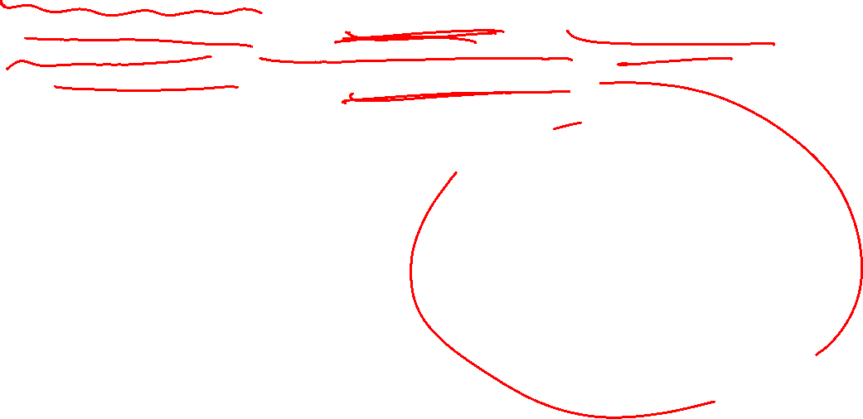
Graph Theory and its Applications
Generative models
A small-world network is a type of mathematical graph in which most nodes are not neighbors of one another, but the neighbors of any given node are likely to be neighbors of each other and most nodes can be reached from every other node by a small number of hops or steps

Slide 11
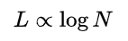
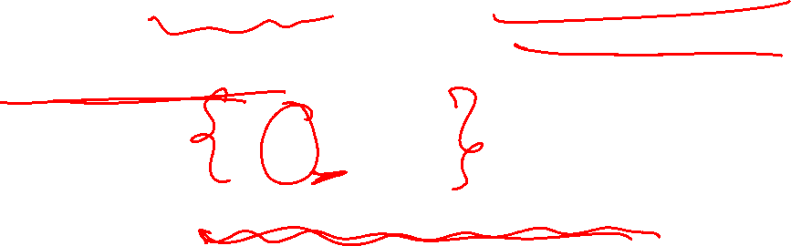
Graph Theory and its Applications
Generative models
A small-world network is defined to be a network where the typical distance L between two randomly chosen nodes (the number of steps required) grows proportionally to the log of the number of nodes N in the network, that is
while the global clustering coeff is not small.

Slide 12
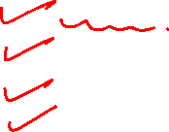
Graph Theory and its Applications
We are going to discuss the following things
Empirical network features:
Power-law (heavy-tailed) degree distribution
Small average distance (graph diameter)
Large clustering coefficient (transitivity)
Giant connected component, hierarchical structure etc.
Scale Free nature
Models
Random graph model (Erdos & Renyi, 1959)
“Small world” model (Watts & Strogatz, 1998)
Preferential attachment model (Barabasi & Albert, 1999)
Myopic search

Slide 13
Graph Theory and its Applications
Our approach
Some of the formula of these models have rigorous mathematical proof .
We will learn the results but may avoid the derivations/proof

Slide 14
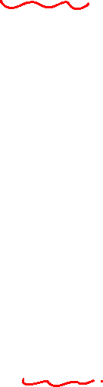
Graph Theory and its Applications
Observed properties of real-world networks that we try to simulate
The properties that are consistently observed in real-world networks are:
Power law degree distribution
Scale Free and Fat Tailed
High clustering coefficient
Small average path length
Note : Real world networks also have Giant Components

Slide 15
Graph Theory and its Applications
Properties : small average path length, large local Clustering Coefficient and giant components

Slide 16
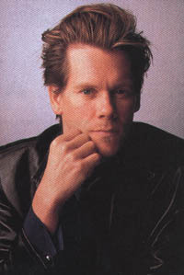

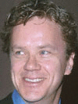


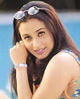

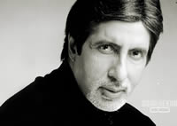

Graph Theory and its Applications
Kevin Bacon game
https://oracleofbacon.org/how.php
Mystic River (2003)
Tim Robbins
Code 46 (2003)
Om Puri
Yuva (2004)
Rani Mukherjee
Black (2005)
Amitabh Bachchan

Slide 17

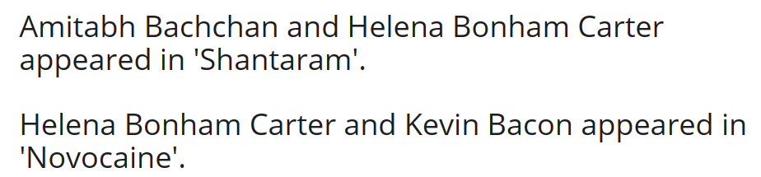
NETWORK ANALYSIS AND MINING
Mr. Bachchan currently has a bacon number 2
Started with Six degrees of Kevin Bacon meme ( nobody in Hollywood is more than 6 hops away from Kevin Bacon ('Footloose’)
Google introduced Six Degrees of Kevin Bacon calculator years ago. The calculator tells you how many contacts away an actor is from the famed Kevin Bacon .
Amitabh Bachchan's Bacon number is 2.
Do you know the 'Bacon Numbers' of these 20 Bollywood celebrities? | Bollywood News, Bollywood Movies, Bollywood Chat (indiaforums.com)

Slide 18
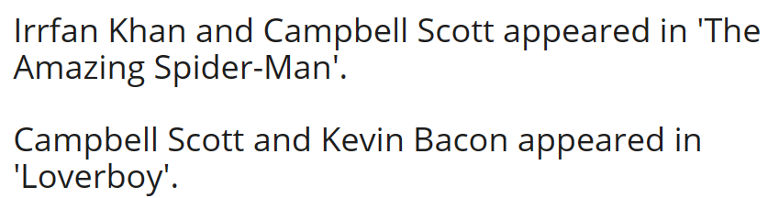
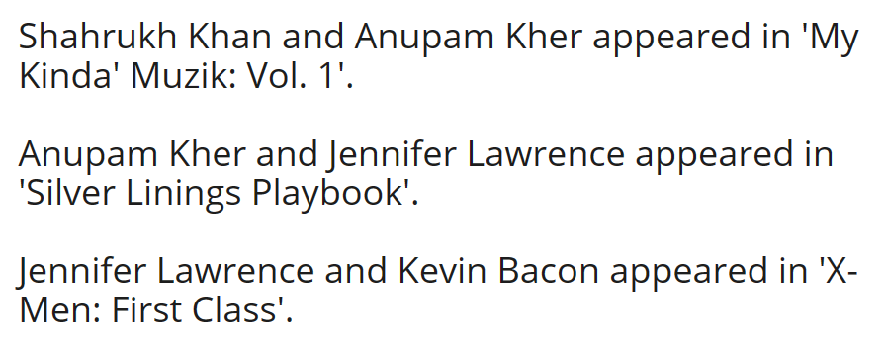
NETWORK ANALYSIS AND MINING
Mr. Bachchan currently has a bacon number 2
Irrfan Khan's Bacon number is 2.
Shahrukh Khan's Bacon number is 3.
Do you know the 'Bacon Numbers' of these 20 Bollywood celebrities? | Bollywood News, Bollywood Movies, Bollywood Chat (indiaforums.com)

Slide 19
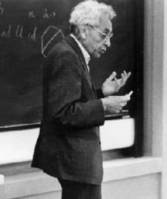
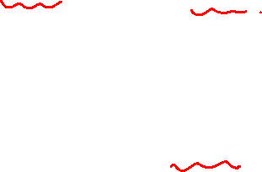
Graph Theory and its Applications
Erdos number
The Erdős number describes the "collaborative distance" between mathematician Paul Erdos and another person, measured by authorship of mathematical papers.
The same principle has been applied in other fields where a particular individual has collaborated with a large and broad number of peers
Paul Erdős (1913-1996)

Slide 20
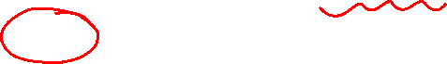
Graph Theory and its Applications
Erdos number
Number of links required to connect scholars to Erdős, via co-authorship of papers
Erdős wrote 1500+ papers with 507 co-authors.
Jerry Grossman’s (Oakland Univ.) website allows mathematicians to compute their Erdos numbers:
http://www.oakland.edu/enp/
Connecting path lengths, among mathematicians only:
average is 4.65
maximum is 13
Paul Erdős (1913-1996)

Slide 21
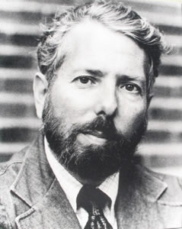
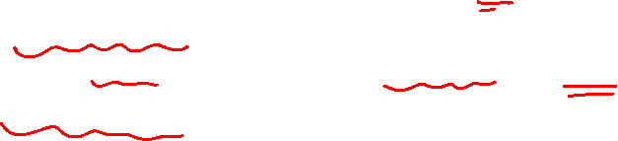
Graph Theory and its Applications
Stanley Milgram’s Experiment – Six Degrees of Separation
The notion of six degrees of separation grew out of work conducted by the social psychologist Stanley Milgram in the 1960s.
Milgram decided to investigate the so-called small-world problem, the hypothesis that everyone on the planet is connected by just a few intermediaries..

Slide 22
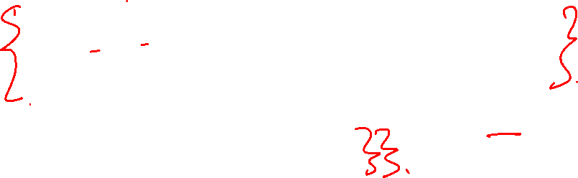
Graph Theory and its Applications
Stanley Milgram’s Experiment – Six Degrees of Separation
Random people from Nebraska were asked to send a letter (via intermediaries) to a complete stranger, a stock broker in Boston
But they could only send the letter to a personal friend whom they thought was somehow closer to the target than they were.
(S/he could only send to someone with whom they were on a first-name basis)
When Milgram looked at the letters that reached the target, he found that they had changed hands only about six times.
Among the letters that reached the target, the average path length was six.

Slide 23
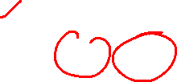
Graph Theory and its Applications
Average shortest path
In real-world networks, any two members of the network are usually connected via short paths - the average path length is small
Six degrees of separation
Stanley Milgram In the well-known small-world experiment conducted in the 1960’s conjectured that people around the world are connected to one another via a path of at most 6 individuals
Four degrees of separation
Lars Backstrom et al. in May 2011, the average path length between individuals in the Facebook graph was 4.7. (4.3 for individuals in the US)
Below is an old measurement

Slide 24
Graph Theory and its Applications
Giant Components
What are the component sizes in a real-world network?
Typically there is a large/giant component that fills most of the network
Even more than 90% of the nodes
Rest of the network is divided in many smaller components disconnected from each other
This large components can arise
either due to the nature of the net-
work (e.g., Internet), or due to the
way the network was measured
(e.g., Web)

Slide 25
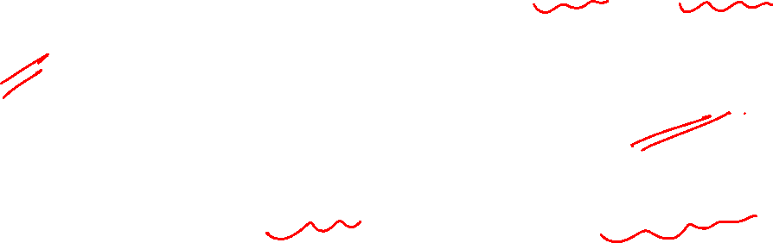
Graph Theory and its Applications
Large Local Clustering Coefficient
In real world social graphs, friendships are highly transitive
Triadic Closure, Focal Closure and Membership Closure are common leading to triad formation
Triad formations result in high Local Clustering Coefficient

Slide 26
Graph Theory and its Applications
A Quick Recap: Types of Closure
1
Triadic closure
Common friend - A is friends with B and A is with friends with C . So, C becomes friend of B
Foci/focal Closure
Two individuals become friends because of their common or shared interest .Two individuals applying for MS in the class and become close to each other. Probability of becoming friends when they have the same foci.
2
Membership Closure
If A is associated with the Rotary club and a friend B, then B also becomes member of Rotary club there is a tendency that B comes close to align the behavior of A.
3

Slide 27
Graph Theory and its Applications
A Quick Recap: Co-Evolution of Social Network
All three types of triadic closure can happen together .
This is co-evolution of social-affiliation network
Bob introduces Anna to Claire
Rotary club introduces Anna to Daniel
Anna introduces Bob to Karate
Claire
Triadic closure (Bob may be the
reason for Claire and Anna to be friends
Bob
Anna
Focal closure
(Similar interest)
Membership closure
(same club or activity)
Rotary
Daniel
Focus

Slide 28
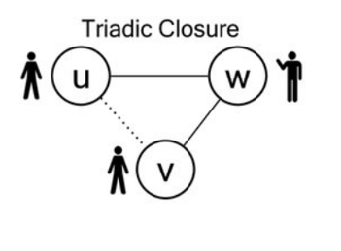
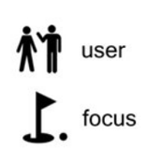
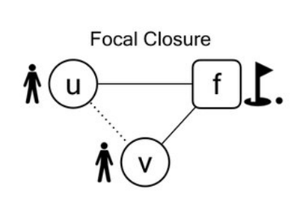
Graph Theory and its Applications
A Quick Recap: Back to…..Types of Closures
It is the tendency of two people to form a link when they have a focus in common.
This is an aspect of the more general principle of selection, forming links to others who share characteristics with you.

Slide 29
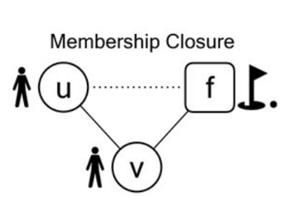
Graph Theory and its Applications
A Quick Recap: Back to…..Types of Closures
If u and v --- people, and f --- focus, then we have the formation of a new affiliation:
u takes part in a focus that her friend v is already involved in.
This is a kind of social influence, in which u’s behavior comes into closer alignment with that of her friend v.

Slide 30
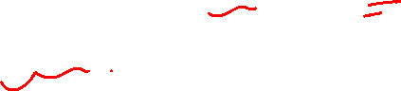
Graph Theory and its Applications
Properties to be modeled : power law degree distribution
Dr. Arti Arya
Department of Computer Science and Engineering

Slide 31
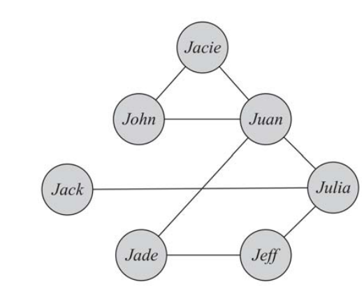
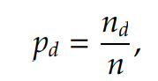
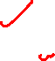
Graph Theory and its Applications
A Quick Recap: Degree Distribution
Degree Distribution: Prob dist. Of the degrees over the whole network.
In very large graphs, distribution of node degrees (degree distribution) is an important attribute to consider.
In a graph with n nodes, p_{d} is defined as
p_{d} is the probability that a randomly chosen node has degree d.

Slide 32
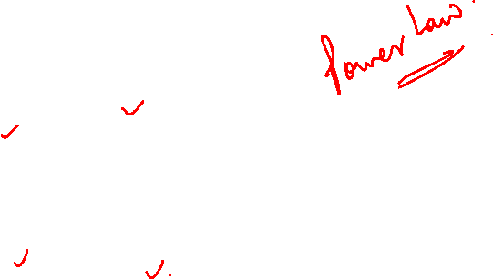
Graph Theory and its Applications
A Quick Recap: Degree distribution

Slide 33
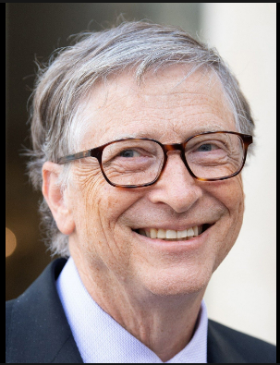
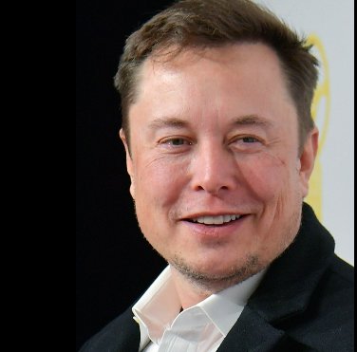
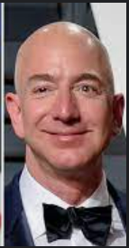
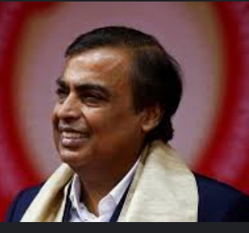
Graph Theory and its Applications
Think of distribution of degrees
Consider the distribution of wealth among individuals.
Few Elon Musk, Jeff Bezos Bill Gates and Ambanis( 9830 crore USD).
Similarly, consider the population of cities.
Very few New York, Mumbai, Shanghai.
In social media, we observe the same phenomenon regularly when measuring popularity or interestingness for entities.
Compare your popularity vs. that of Virat Kohli.

Slide 34
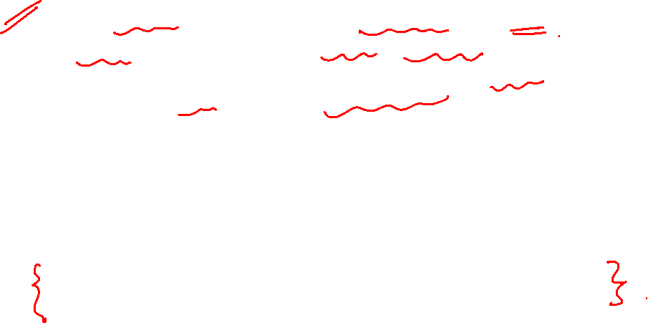
Graph Theory and its Applications
Think of distribution of degrees
Examples from internet world ( skewed popularity)
Many sites are visited less than a 1,000 times a month whereas a few are visited more than a million/billion times daily.
Most social media users are often active on a few sites whereas few individuals are active on hundreds of sites.
There are exponentially more modestly priced products for sale compared to expensive ones.
There exist many individuals with a few friends and a handful of users with thousands of friends.
Point to ponder :
Google’s Adword business model relies on millions of small websites rather than few big.
Business model (cloud based) has changed from “head” to “tail”.

Slide 35
Graph Theory and its Applications
Just FYI
Using Google AdWords is a common and effective marketing strategy among businesses looking to get their first online customers.
Google AdWords is a powerful tool when it comes to advertising a business online.
With Google’s many targeting options, business owners are able to ensure their ad is only displayed to potential customers.
Business owners can filter their audience on the basis of geographical location, age, keywords and more.
Businesses can also choose the time of day when their ads will be displayed to their targeted audience. A common example that a lot of businesses use is running ads only from Monday – Friday from 8 AM to 5 PM.

Slide 36
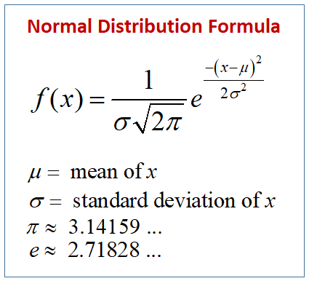
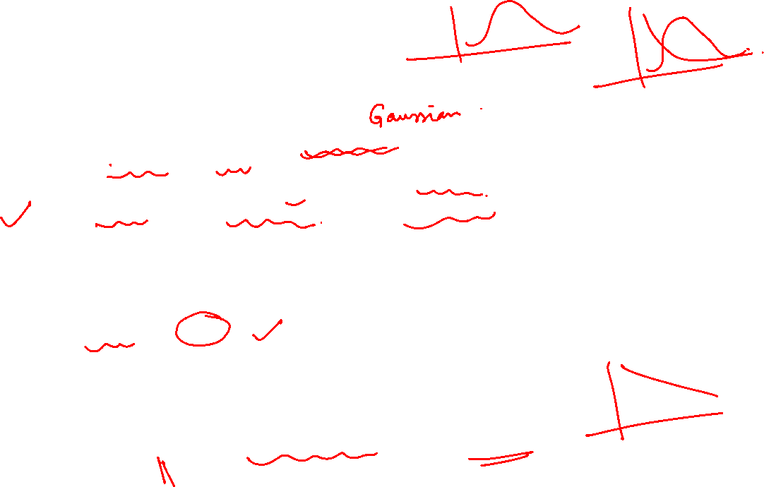
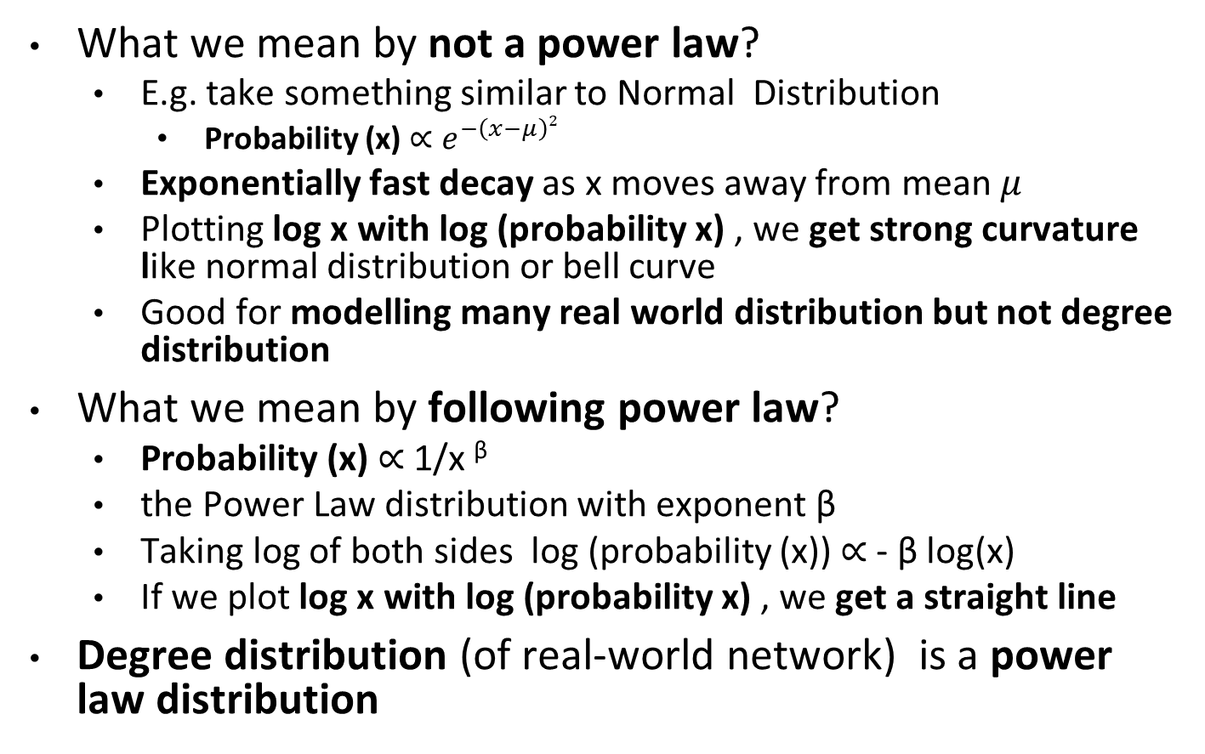
Graph Theory and its Applications
Power law distribution
What we mean by not a power law?
E.g. take something similar to Normal Distribution
Probability (x) $∝e^{−\left(x−μ\right)2}$
Exponentially fast decay as x moves away from mean $μ$
Plotting log x with log (probability x) , we get strong curvature like normal distribution or bell curve
Good for modelling many real world distribution but not degree distribution
What we mean by following power law?
Probability (x) $∝$ 1/x ^{β}
the Power Law distribution with exponent β
Taking log of both sides log (probability (x)) $∝$ - β log(x)
If we plot log x with log (probability x) , we get a straight line
Degree distribution (of real-world network) is a power law distribution

Slide 37
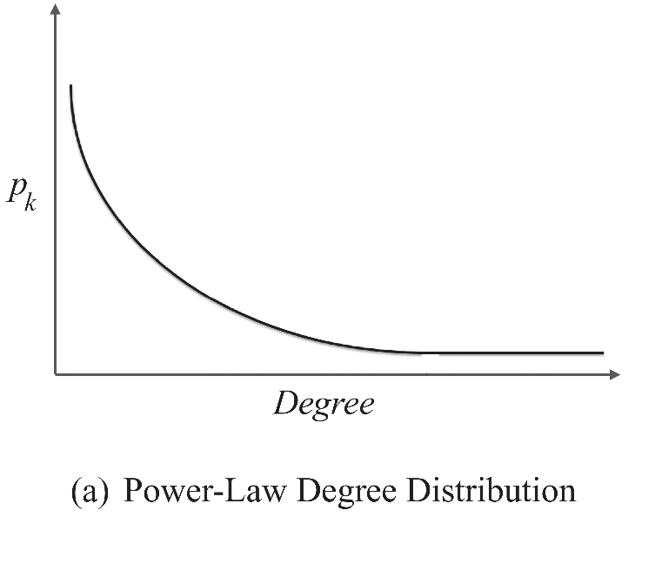

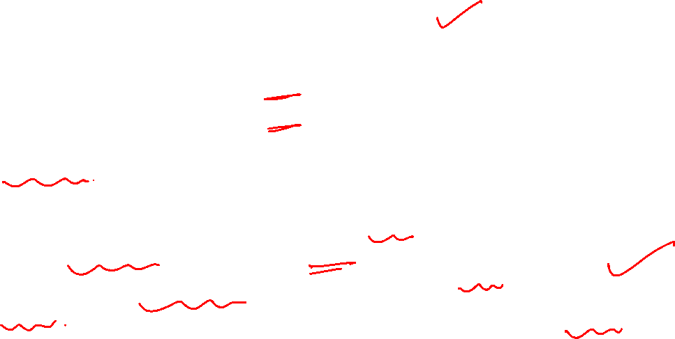
Graph Theory and its Applications
Power law distribution of degree
Many real-world networks exhibit a power-law distribution.
Power laws seem to dominate in cases where the quantity being measured can be viewed as a type of popularity.
A power-law distribution implies that small occurrences are common, whereas large instances are extremely rare
A typical shape of a power-law distribution
Log-Log plot

Slide 38
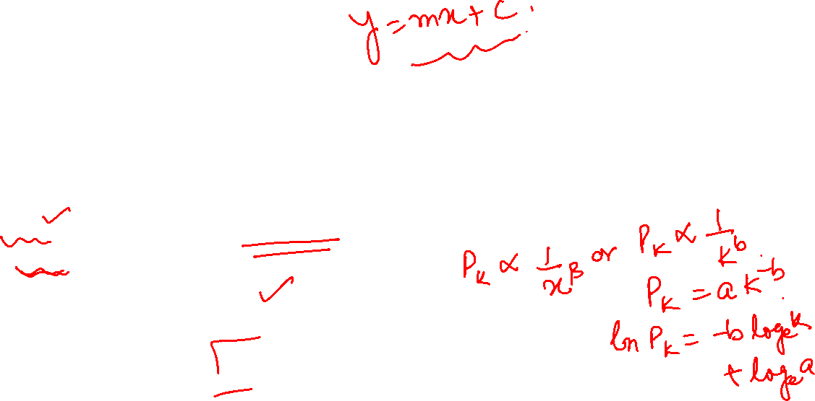
Graph Theory and its Applications
Expressing a power law distribution
When the frequency of an event changes as a negative power of an attribute -> the frequency follows a power-law
Let p(k) denote the fraction of individuals having degree k.
b: the power-law exponent and its value is typically in the range of [2, 3]
a: power-law intercept

Slide 39
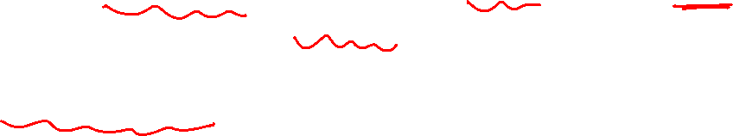
Graph Theory and its Applications
How to test for existence of power law ?
Pick a popularity measure and compute it for the whole network. For instance, we can take the number of friends in a social network
Compute p(k), the fraction of individuals having popularity k.
Plot a log-log graph, where the x-axis represents ln k and the y-axis represents ln p(k).
If a power-law distribution exists, we should observe a straight line
If it does not, it does NOT look like a network with a power law (a real life network) !

Slide 40

Graph Theory and its Applications
Power Law in Degree Distribution in Real World Social Graphs

Slide 41
Graph Theory and its Applications
Scale Free and Fat Tailed …
Dr. Arti Arya
Department of Computer Science and Engineering

Slide 42

Graph Theory and its Applications
Scale free ?
A Scale Free Network is one in which the distribution of links to nodes follows a power law.
Or A scale-free network is one with a power-law degree distribution
Networks with power-law distributions are called scale-free because power laws have the same functional form at all scales i.e. remains unchanged other than a multiplicative factor when rescaling the independent variable k
p_{k} = a(ck)^{-b} = a.c^{-b} .k^{-b} = a’ .k^{-b}

Slide 43

Graph Theory and its Applications
Scale free networks examples
Several networks are claimed to be scale-free
World wide web
Social networks, including collaboration networks. Two examples that have been studied extensively are the collaboration of movie actors in films and the co-authorship by mathematicians of papers.
Some financial networks such as interbank payment networks
Protein-protein interaction networks.
Semantic networks
Airline networks.

Slide 44


Graph Theory and its Applications
Scale free networks are also fat tailed network
Additionally, scale-free networks are a type of network characterized by the presence of large hubs. (A hub is a node with a number of links that greatly exceeds the average.)
Also known as heavy tails, fat tails describe the greater-than-expected probabilities of extreme values.
If in a Gaussian distribution there is, say, a 1% chance of a quantity taking values greater than some extreme value, this probability will be higher in a fat-tailed distribution.

Slide 45

Graph Theory and its Applications
Scale free networks are also fat tailed network
We call a network fat tailed if its degree distribution follows power law and a tail in the high-k region.
Outliers, or exceptionally high-degree nodes, are not only allowed but are expected in these networks

Slide 46

Graph Theory and its Applications
Scale free networks
Random Network Scale Free Network
Scale-free network follows power-law and is inhomogeneous. Most nodes have one or two links but a few highly-connected nodes, so-called hubs,(have a large number of links). Eg The airline network, follow scale-free network. White circles indicate nodes and dark ones indicate hubs that are highly connected nodes.
Random network follows Poisson distribution and is nearly homogenous. Most nodes have approximately the same numbers of links. The road system, for example, fits with this type of network model.

Slide 47
Graph Theory and its Applications
Scale free network properties
A scale-free network is a network whose degree distribution follows a power law, at least asymptotically.
The fraction p(k) of nodes in the network having k connections to other nodes is p(k) = a. k ^{-b} where b is a parameter in the range of 2 and 3 typically & a > 0 typically
Another important characteristic of scale-free networks is the clustering coefficient distribution, which decreases as the node degree increases. This distribution also follows a power law.
This implies that the low-degree nodes belong to very dense sub-graphs
Interpretation : those sub-graphs are connected to each other through hubs as most scale free networks are heavy or fat tailed.

Slide 48

Graph Theory and its Applications
Scale free networks – other properties
Scale-free networks also exhibit small-world phenomena
For a random graph having the same power law distribution as the Web graph, it has been shown that i.e. Avg path length = 0.35 + log₁₀ N
Scale-free networks tend to be more brittle
You can drastically reduce the connectivity by deliberately taking out a few nodes, specially the hubs
This can also be seen as an opportunity..
Disease prevention by quarantining super-spreaders
Bar´abasi-Albert (BA) model was the first model for scale free networks (coming later …)

Slide 49

Graph Theory and its Applications
Small-world Phenomenon
The small-world experiment comprised several experiments conducted by Stanley Miligram and other researchers examining the average path length for social networks of people in the USA.
The research was groundbreaking in that it suggested that human society is a small-world type network characterized by short path-lengths.
The experiments are often associated with the phrase “ Six degrees of Separation”, although Milgram did not use this term himself.

Slide 50

Graph Theory and its Applications
Pareto law and Power Law
Pareto Law is also called 80-20 rule
Merely an observation (it may be 70-20 !) and not a rule
Essentially means 20 % causes decides the 80% of effects
Examples : 20% of population owns 80% of the wealth, 20% of world’s rivers carry 80% of world’s river water, 20% of the bugs can decide 80% of the software performance ( bug triaging is a process to detect that 20%)
It also means things in life are not distributed uniformly . Pareto distribution (by Dr. Juran ) is a skewed, heavy-tailed distribution that is sometimes used to model that distribution of incomes.
Pareto law is in terms of CDF( cumulative distribution function) i.e. no of events larger than x is an inverse power k of x ( it was devised for income distribution)

Slide 51


Graph Theory and its Applications
Zipf’s law
Zipf’s law : given some corpus of natural language utterances, the frequency of any word is inversely proportional to its rank in the frequency table i.e. y ~ r^{-b}
Zipf’s law refers to size of an occurrence with respect to its rank
Thus the most frequent word will occur approximately twice as often as the second most frequent word, three times as often as the third most frequent word etc

Slide 52
Graph Theory and its Applications
Zipf’s law, Pareto law and Power law
Intuitively, power law distribution tells us not how many people had an income greater than x, but the number of people whose income is exactly x. It is simply the probability distribution function (PDF) associated with the CDF given by Pareto's Law.
Zipf’s law and Pareto both look at the same thing in a different way i.e. one produced by ranking variable (Zipf’s ) and the other produced by looking at the distribution of frequency ( Pareto)
Cumulative Distribution with a power law resembles Pareto and Zipf’s law

Slide 53

THANK YOU
Dr. Arti Arya
Department of Computer Science and Engineering

